Slide 1
Arizona tableau
File created on: 2/13/2024 8:26:19 PM

Slide 2
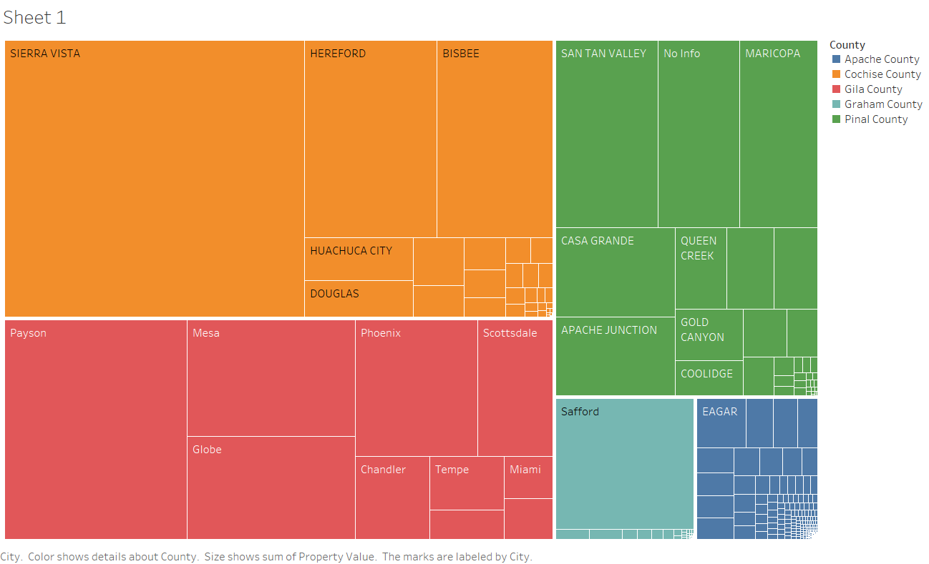

Slide 3
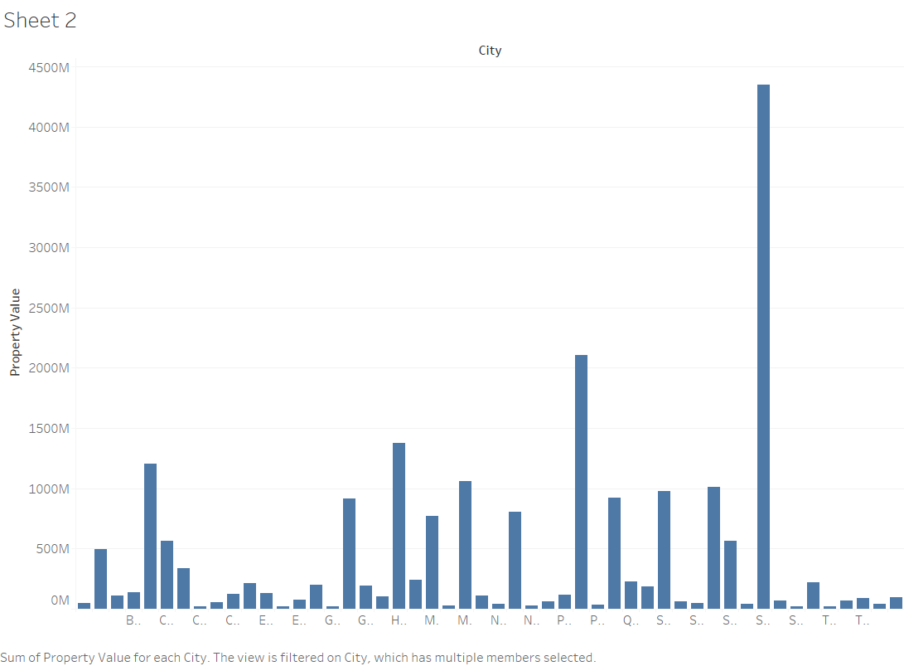

Slide 4
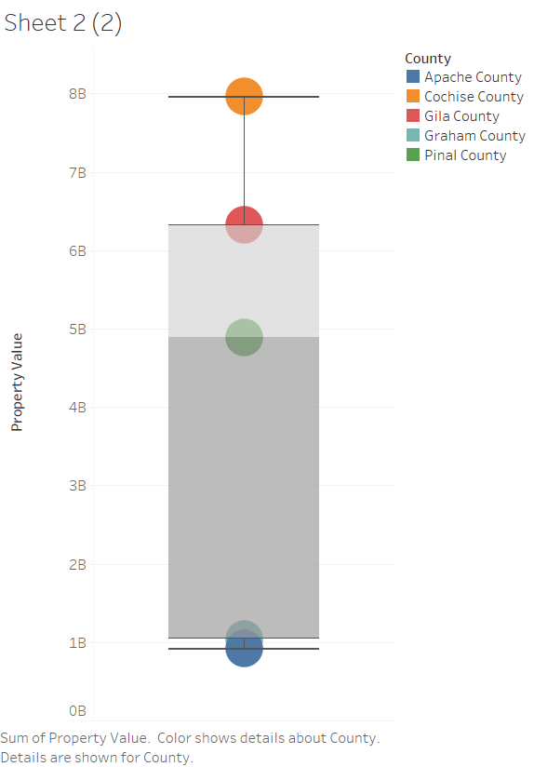

Slide 5


